Slide 1
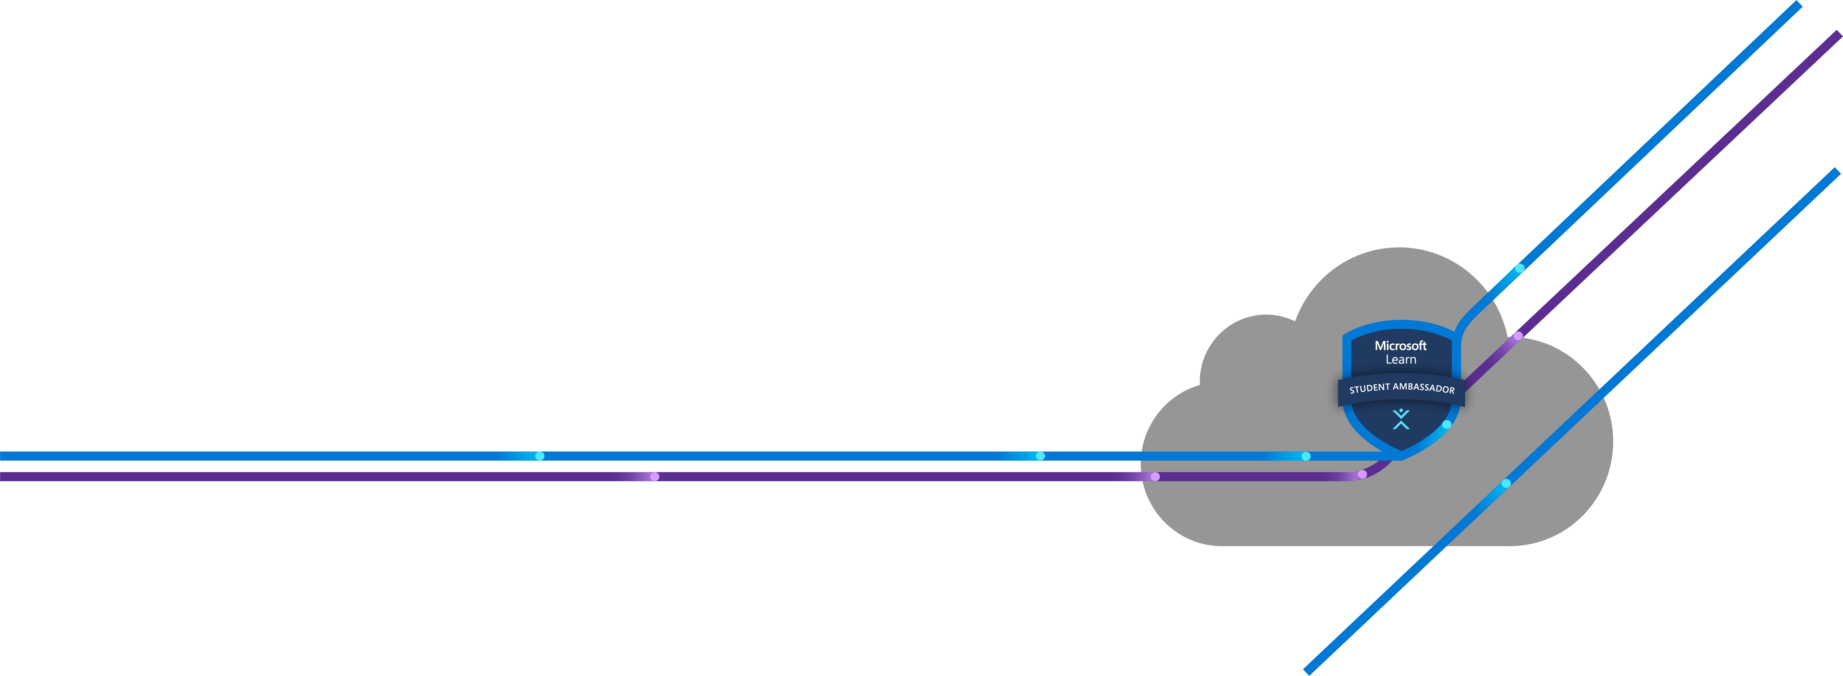





Waiting for participants

Slide 2

All about MLSA
BY :-
Awais Naeem.
BETA Microsoft Learn Student Ambassador
Chief Business Officer(CBO) at Blunder Bot Technologies
BSCS . 3rd Year -Fast-National University of Science and Technology(NUCES)

Slide 3
1. What is MLSA
2. How to apply?
AGENDA
3. Benefits & Stages
4. My Journey

Slide 4
1. What is MLSA

Slide 5

What is MLSA
Microsoft Learn Student Ambassadors
Formerly – Microsoft Student Partners (MSP). Global community of students who are passionate about technology.
Responsibility – Building strong technical community by hosting workshops, meetups, hackathons and mentoring fellow students.
Eligibility – Minimum of 16 years and enrolled full – time in an accredited academic institution.

Slide 6
2. How to apply?

Slide 7

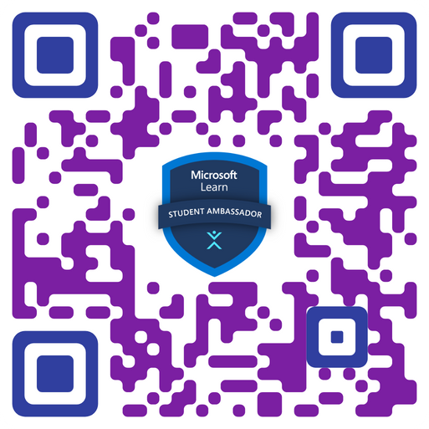

How to apply?
Microsoft Learn Student Ambassadors
Submit an application
Info/Questions
https://studentambassadors.microsoft.com/en-US/apply
Give answers naturally.
Open throughout the year.

Slide 8
3. Benefits

Slide 9






Benefits
Microsoft Learn Student Ambassadors
Access to global student network on Microsoft Teams
Free access to Microsoft software’s and many more.
Free access to Microsoft Certification Exams & traveling opportunities.
Technical skills in various field like AI, ML, IoT by Microsoft Technologies.
Awesome goodies like T-shirt, backpacks, water bottle etc.
Chance to improve soft skills like public speaking skills, presentation skills, etc.

Slide 10
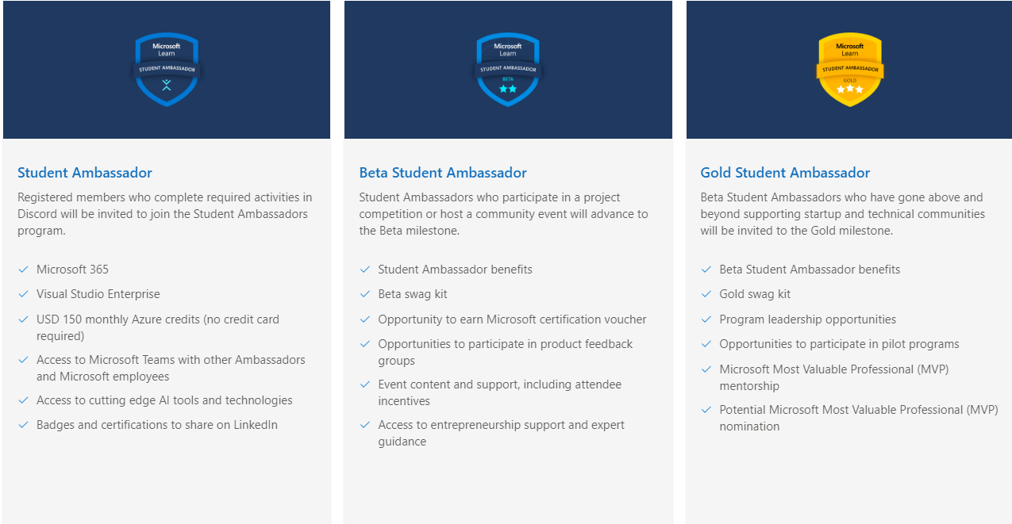

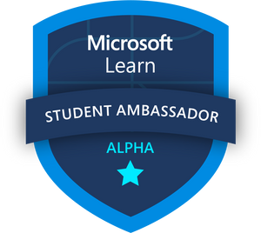
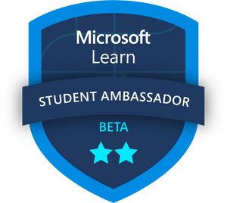
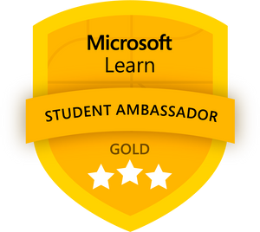

Stages
Microsoft Learn Student Ambassadors
APPLY
ALPHA
BETA
GOLD
NEW
Selection Mail
Microsoft 365 Premium
USD150 monthly Azure credits
Visual Studio Enterprise subscription
MTC certification exam voucher
StudentAmbassadors.com domain name
Alpha benefits
Swag Kit
Event Support
Mentorship
Access to Ambassador Summit
Alpha and Beta benefits
Access special events and speaking engagements
Program Leadership opportunities
Participate in pilot program
Microsoft Most Valuable Professional (MVP) Mentorship
May be invited to the MVP program

Slide 11
4. My Journey

Slide 12
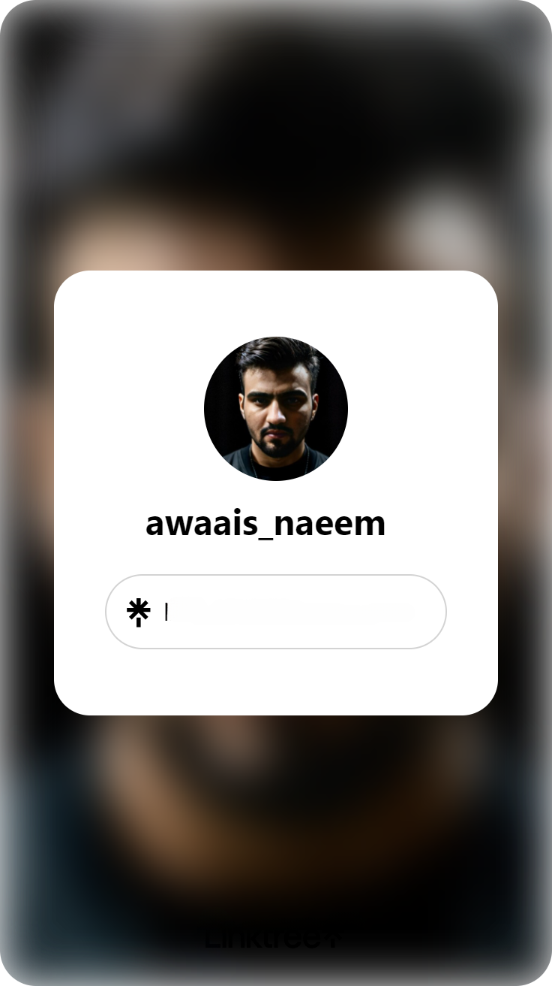
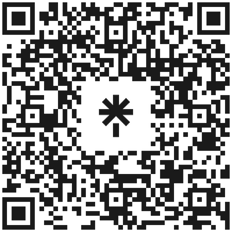
My Journey
Microsoft Learn Student Ambassadors
https://linktr.ee/awaais_naeem

Slide 13
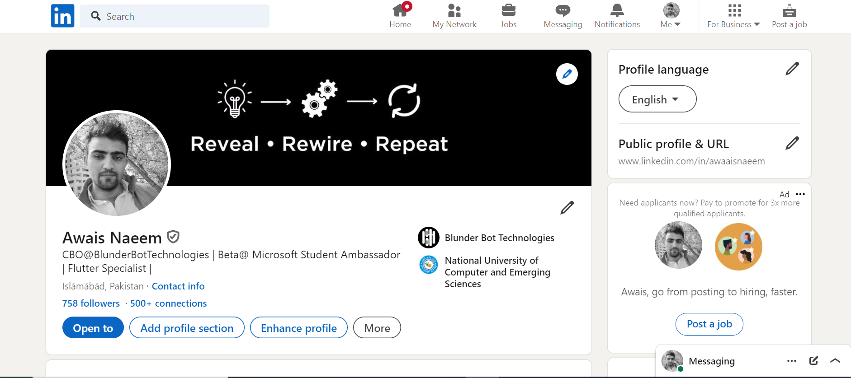
My Journey
Microsoft Learn Student Ambassadors

Slide 14
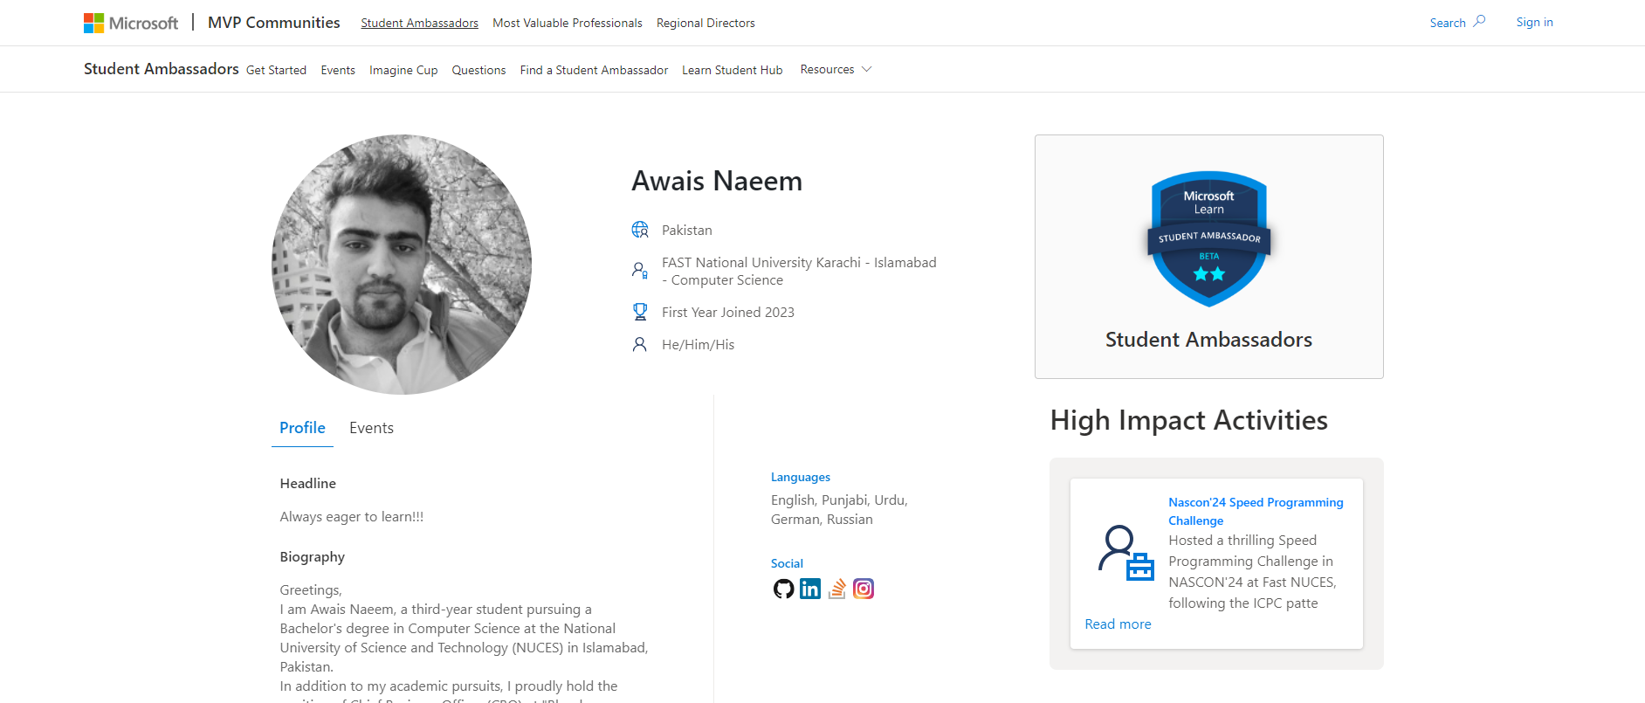
My Journey
Microsoft Learn Student Ambassadors

Slide 15



THANK YOU

